Slide 2
Oral Statements
Oral statements or discussion during the pre-bid meeting today will not be binding, nor will it change or affect the terms or conditions within the Plans and Specifications of this Project. Changes, if any, will be addressed in writing only via an Addendum.

Slide 3
General Information
Non-Mandatory pre-bid meeting
Presentation and the attendance sheet will be posted to the SAWS website
Construction services being procured through IFB

Slide 4
Agenda
General Information
Small, Minority, Women and Veteran-Owned Business (SMWVB Requirements)
Vendor Registration
Bid Packet Preparation
Contract Requirements
Addendums
Bid Opening Dates/Time
Technical Information

Slide 5
General Information
Estimate: $2,462,852.65
Calendar days:
297 days

Slide 6
Aspirational SMWB Goal
Industry | Aspirational SMWB Goal
Construction | 20%
The aspirational SMWB goal is 20% of your total bid price.
Notes:
Contracting

Slide 7
Accepted SMWVB Certification Agency
South Central Texas Regional Certification Agency
  MBE, WBE, SBE (Includes “HUB” Program)
Minimum Qualifications for SMWVB recognition:
SBE-Certified (even MBEs and WBEs)
Local office or local equipment yard

Slide 8
Good Faith Effort Plan (GFEP) FAQs
Q: Is the 20% SMWB goal mandatory?
A: No, but we ask prime contractors to do their best with good faith outreach efforts. If the goal is not met, proof of outreach efforts is required with the submittal.
Q: What if I am having trouble finding SMWB subcontractors?
A: Please email the SMWVB Program Manager with the scopes of work you are seeking. You will receive lists of local SMWVB-certified firms to contact.
Q: What if my business is SMWB-certified? Do I need to find SMWB subs?
A: If your firm is SMWVB-certified, you will most likely meet the goal. However, the GFEP is a required document, and a good faith outreach effort is still necessary.
Q: Do I need to include all my subcontractors in the GFEP or just those that qualify towards the
SMWB goal?
A: All subcontractors need to be included in the GFEP, even those that may not count towards the SMWB goal.
Q: What if I have questions about the GFEP?
A: Please contact the SMWVB Program Manager at 210-233-3420, or at Marisol.Robles@saws.org . GFEP questions can be asked at any time before the submittal is due.
Notes:
SMWB

Slide 9
Post Award: Subcontractor Payment & Utilization Reporting (S.P.U.R.) System
1. Subcontractor & Supplier Payment Tracking
2. Subcontractor and Supplier Additions or Substitutions
3. LCP Tracker
4. Must be Current and Accurate before Retainage is released https://saws.smwbe.com

Slide 10
Contract Requirements
Prevailing Wage Rate and Labor Standards – Section 2.10 of the General Conditions
Certified payroll to be submitted on weekly basis
Wage decisions are included within the specifications
Contractors to utilize LCP Tracker
Site visits are random and unannounced
Interviews will be Conducted and will be private & confidential
Payroll records are subject to review
All apprenticeship programs will need to be approved by Department of Labor prior to starting
Contractors are responsible for sub-contractor payroll
Late payrolls delay contractor payments from SAWS

Slide 11
Contract Requirements
Insurance requirements are found in Section 5.7 of the GCs
  Pollution Liability & Installation Floater is required
  Maintain insurance coverage during the construction of this Project
Compliant prior to executing the contract
Will ask for insurance prior to Board award to expedite execution of the contract
  Any deficiencies must be corrected prior to Board award

Slide 12
Bid Packet Preparation
Utilize the Bid Packet Checklist within the specifications
Double check all mathematical calculations and verify all extensions
Ensure Mobilization & Prep ROW Line Item does not exceed the percentage allowed
References and contact information must be verified prior to submitting
Addendums are acknowledged on the Bid Proposals
A baseline schedule should be part of the Bid Packet with an assumed date of January 4, 2021.

Slide 13
Addendum(s)
Revisions, Clarifications, Questions and Answers (Q&A’s)
Questions deadline is October 5, 2020 by 2 P.M.
Q&A’s will be posted on SAWS website on October 8, 2020 by 2 P.M.
All questions should be sent in writing via email or fax.
Check our website regularly for addendum postings .
It is possible to have multiple addendums during the time frame in addition to the scheduled final addendum.

Slide 14
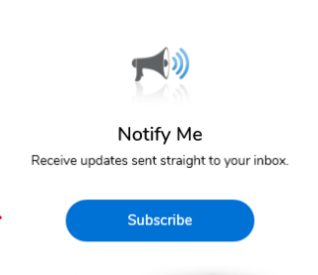
Vendor Registration & Notification (VRN)
Please register through SAWS Vendor Registration Program on the SAWS website at www.saws.org to ensure access to the latest information.
To receive updates on specific projects, registered vendors must ‘Subscribe’ to the project by selecting the project, and clicking ‘Subscribe’ under the Notify Me box.
https://apps.saws.org/Business_Center/Contractsol/

Slide 15
Bid Opening Dates/Times
October 19, 2020 at 2 PM
Bids will be received either Electronically or through Sealed bids.
Electronic bids will be received via the secure SAWS FTP site.
Bids may not be late
  Late bids will not be accepted and will be returned unopened
Sealed bids will be received by Contract Administration, 2800 U.S. Hwy 281 North, Tower II, Customer Service Building, via a drop box located on the left wall when walking through the first set of double glass doors of the main Tower II entry on the north side of the building.
If delivering in person to SAWS, Bidders should allow sufficient travel time.

Slide 16
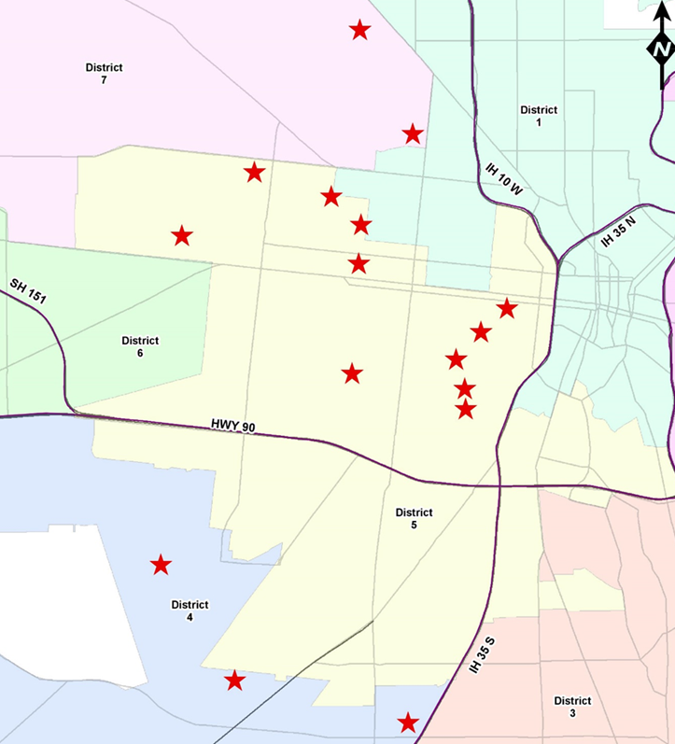
Project Background
Sealed bids are requested by the San Antonio Water System for the construction of approximately 5,138 LF of 8-15 inch sanitary sewer pipe via Pipe Burst and Open Cut methods
Project is part of the Consent Decree
Contractor is to become familiar with the plans, specifications, and project locations
Notes:
SAWS PE slides

Slide 17
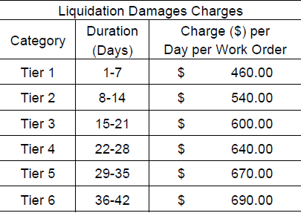
Contract Requirements
Supplemental Conditions
Contractor shall perform the work with its own organization on at least 40% of the total original contract price which should be indicated on the Good Faith Effort Plan.
Bidder is required to submit Statement of Bidders Experience as part of their bid.
Liquidated damages will be assessed as follows for final completion extending beyond contract time:
Any days tallied after 42 days will be assessed as a Tier 6 rate.

Slide 18
Special Conditions
Contractor to submit a completion report when the project is complete
  Pre and post MPEG-1 video and video logs
  Any tests and/or submittals specified in the Contract Documents
Payment
  The unit price cost for items shall include all the necessary incidental work as subsidiary to the item unless otherwise specifically called out in the plans or approved by SAWS
Notes:
SAWS PE slides

Slide 19
Supplemental Conditions
Worksite
  No excavation work of any kind may begin until authorized by SAWS
  Preliminary work such as televising, utility investigation/potholing, setup and testing of bypass pumping may not begin until approval in writing by SAWS
Consent Decree Notice Provisions
  Retention of documents
  Notification of events that may cause delay
  Liability for stipulated penalties
Notes:
SAWS PE slides

Slide 20
Special Provisions to Technical Specifications
ITEM NO. 530 (BARRICADES, SIGNS, AND TRFFIC HANDLING)
  Contractor shall provide at least three (3) days advance notification to impacted residents and businesses by distributing door hangers.
  Portable Electronic Message Board Signs shall be measured and paid separately per each site per month (MO) when requested by the inspector.
ITEM NO. 540 (TEMPORARY EROSION, SEDIMENTATION AND WATER POLLUTION PREVENTION CONTROL)
  Measurement and payment for this item to be lump sum.
ITEM NO. 851 (EXISTING MANHOLE ADJUSTMENT)
  Payment for manhole adjustment shall include ring and cover replacement, flowable fill backfill and manhole concrete encasement.
Notes:
SAWS PE slides

Slide 21
Special Provisions to Technical Specifications
ITEM NO. 865 (BYPASS PUMPING - SMALL DIAMETER SANITARY SEWERS)
  Contractor is responsible for determining if suction or discharge manhole ring and cover has sufficient dimensions to accommodate bypass pumping and shall remove as necessary.
  Measurement and payment of bypass pumping to be lump sum per site.
ITEM NO. 910 (MANHOLE REHABILITATION)
  Specifies approved materials for Cementitious and epoxy coatings.
ITEM NO. 1103 (POINT REPAIRS AND OBSTRUCTION REMOVALS)
  20 feet minimum length of point repair.
Notes:
SAWS PE slides

Slide 22
Project Details
Final completion of the project, including all project work sites, shall be achieved in 297 calendar days from Notice to Proceed start date.
Work sites are grouped into Project Groups (#1 to #3). Contractor may only have one (1) ‘Project Group’ under construction concurrently as long as the detour routes do not overlap. Contractor must request and receive written approval to work in additional work sites from SAWS up to 10 days prior to anticipate mobilization on site.
Project Group #1 will require subsequent mill and overlay; this mill and overlay work will be completed under a separate contract.
Contractor shall prioritize complete of Project Group #1; upon completion, Contractor may proceed to either Group #2 or Group #3.

Slide 23
Project Details (cont.)
After substantial completion has been achieved for a Work Site, final completion must be completed within 30 calendar days.
Final completion is declared when the final punch list is approved by SAWS, all infrastructure is in the ground, and when final trench repair pavement and surface restoration is completed.
Contractor’s responsibility for the preparation, submittal, and layout of the site-specific submittals, including SWPPP, Traffic Control Plan, Bypass Pumping Plan, and its approvals.
No excavation work of any kind may begin until authorized by SAWS. Preliminary work, such as televising, utility investigations, utility potholing, setup and testing of bypass pumping, may not begin unless approved in writing by SAWS.

Slide 24
Project Details (cont.)
Contractor responsible for obtaining Right-of-Entry from affected property owners to enter said property for purposes of construction ingress and egress to and from SAWS facilities and bypass pumping operations.
SAWS has obtained a Floodplain Development Permit and Tree Permit from CoSA.
Contractor is responsible for all other required permits per the General Conditions.
Contractor must notify VIA a minimum of one (1) day before any work that requires temporary closure of a bust stop.
Contractor shall begin coordination efforts with CPS Energy immediately after Notice to Proceed is issued.

Slide 25
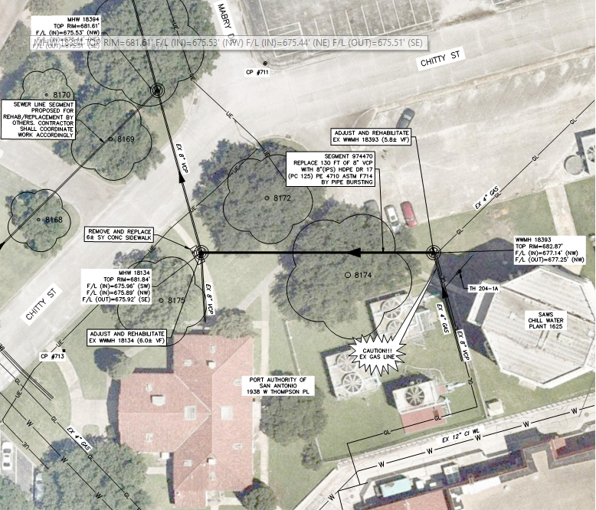
Project Details (cont.)
Work Site 204 is in Port of San Antonio and requires coordination with SAWS inspectors for concurrent work on upgrades to the Cooling plant withing Port SA.

Slide 26
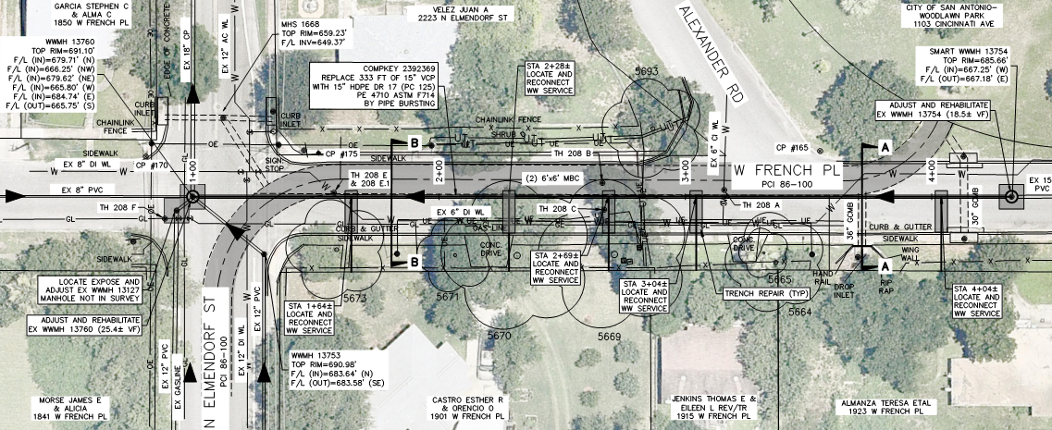
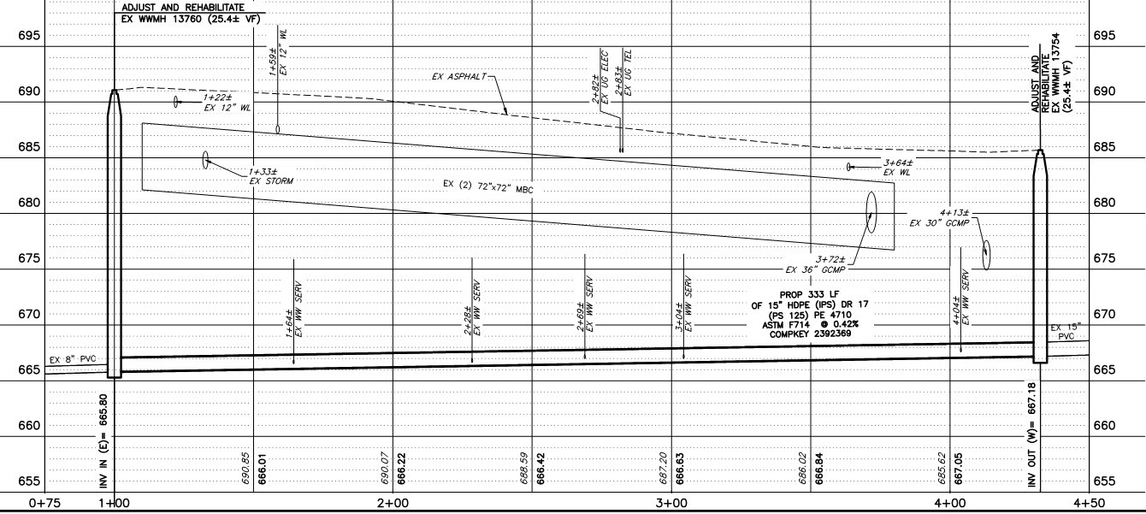
Project Details (cont.)
Work Site 208 is deep pipe burst of 15-inch sewer.

Slide 27
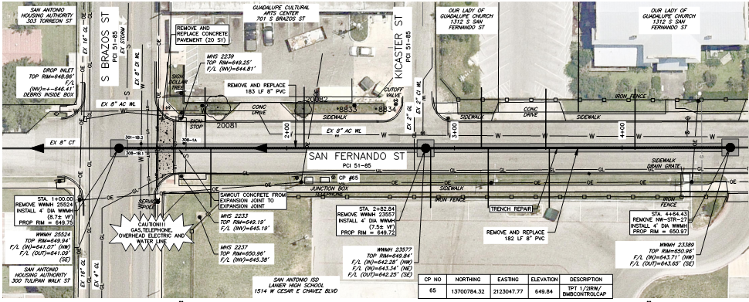
Project Details (cont.)
Work Sites 308-1 and 308-2 require coordination with SAISD and Lanier High School for coordination on work hours and providing suitable accommodations for school traffic.

Slide 28
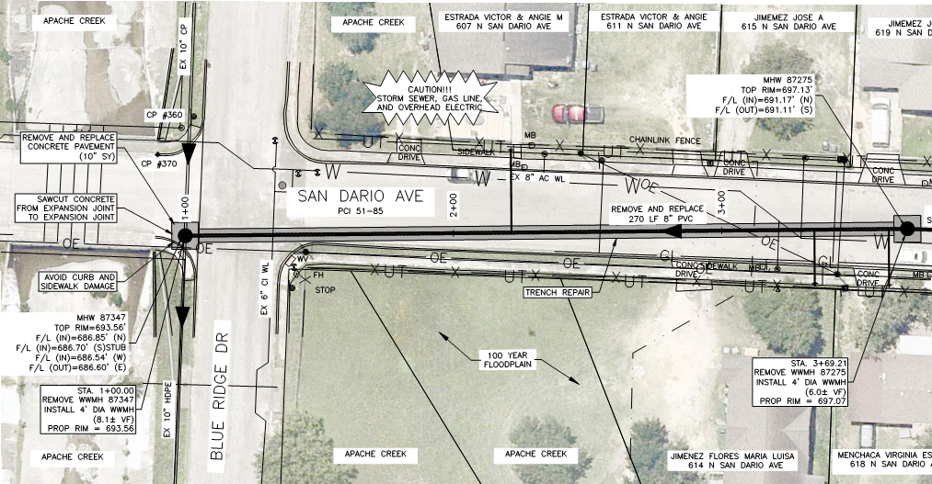
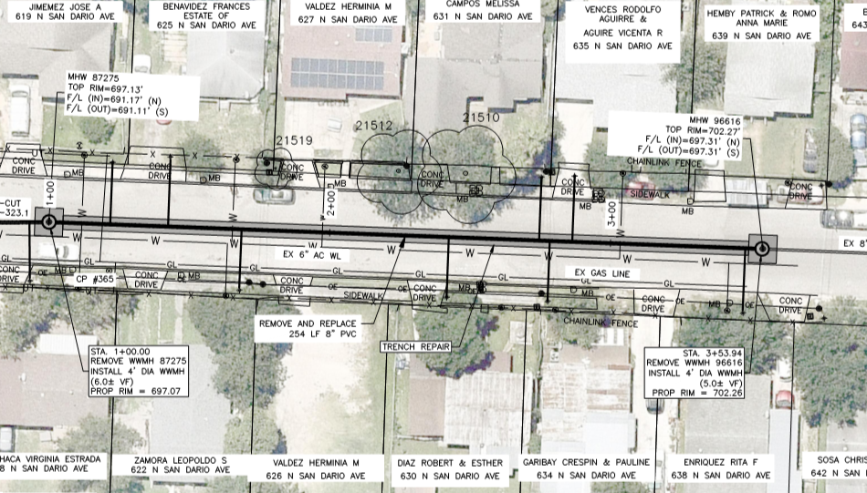
Project Details (cont.)
Work Sites 323-1 and 323-2 require coordination with local businesses.

Slide 29
Key Dates
Date | Action
WebEx Non-Mandatory Pre-Bid | Monday, September 28, 2020 at 10:00 AM
Questions Due | Monday, October 5, 2020 by 2:00 PM
Addendum Posted | Thursday, October 8, 2020 by 2:00 PM
FTP Request | Friday, October 16, 2020 by 2:00 PM
WebEx Bid Opening | Monday, October 19, 2020 at 2:00 PM

Slide 30
Contact Information
Contact Name | Title | Telephone Number | Email address
Roxanne Lockhart | Contract Administrator | 210-233-3095 | Roxanne.Lockhart@saws.org
Marisol Robles | SMWVB Program Manager | 210-233-3420 | Marisol.Robles@saws.org
REMINDER
Please be advised that Bidders are prohibited from communicating with any other SAWS staff, the Consultant, the Developer, or City of San Antonio officials regarding this IFB up until the contract is awarded as outlined in the Instructions to Bidders

